Slide 1
Recitation : 4 Part 2 CNN Back Propagation Spring 2021
Introduction to Deep Learning
Tanya Akumu & Shayeree Sarkar

Slide 2
Backpropagation in CNNs
In the backward pass, we get the loss gradient with respect to the next layer
In CNNs the loss gradient is computed w.r.t the input and also w.r.t the filter.

Slide 3
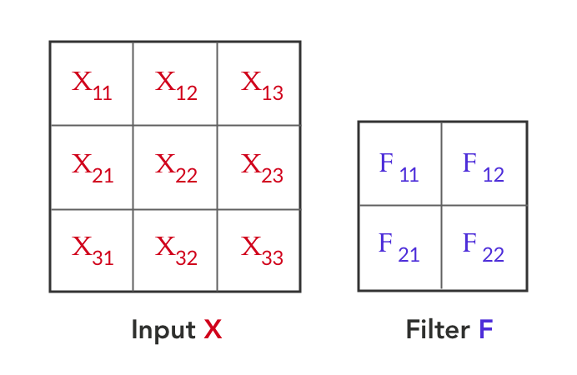
Convolution Backprop with single Stride
To understand the computation of loss gradient w.r.t input, let us use the following example:
Horizontal and vertical stride = 1

Slide 4
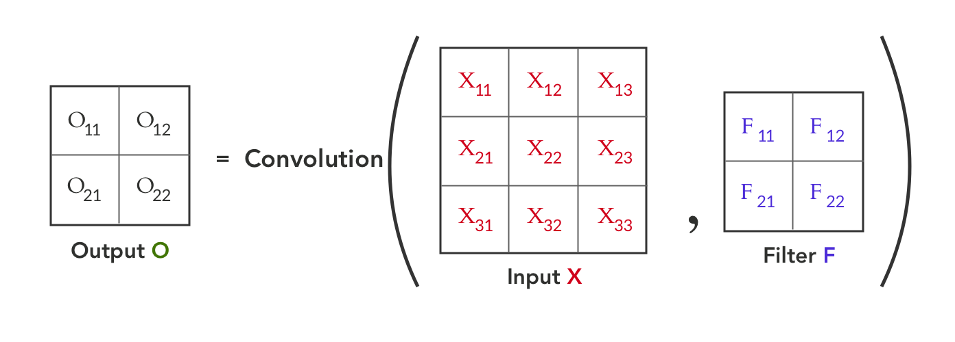
Convolution Forward Pass
Convolution between Input X and Filter F, gives us an output O. This can be represented as:

Slide 5
Convolution Forward Pass
Convolution between Input X and Filter F, gives us an output O. This can be represented as:

Slide 6
Loss gradient
We want to calculate the gradients wrt to input ‘X’ and filter ‘F’

Slide 7
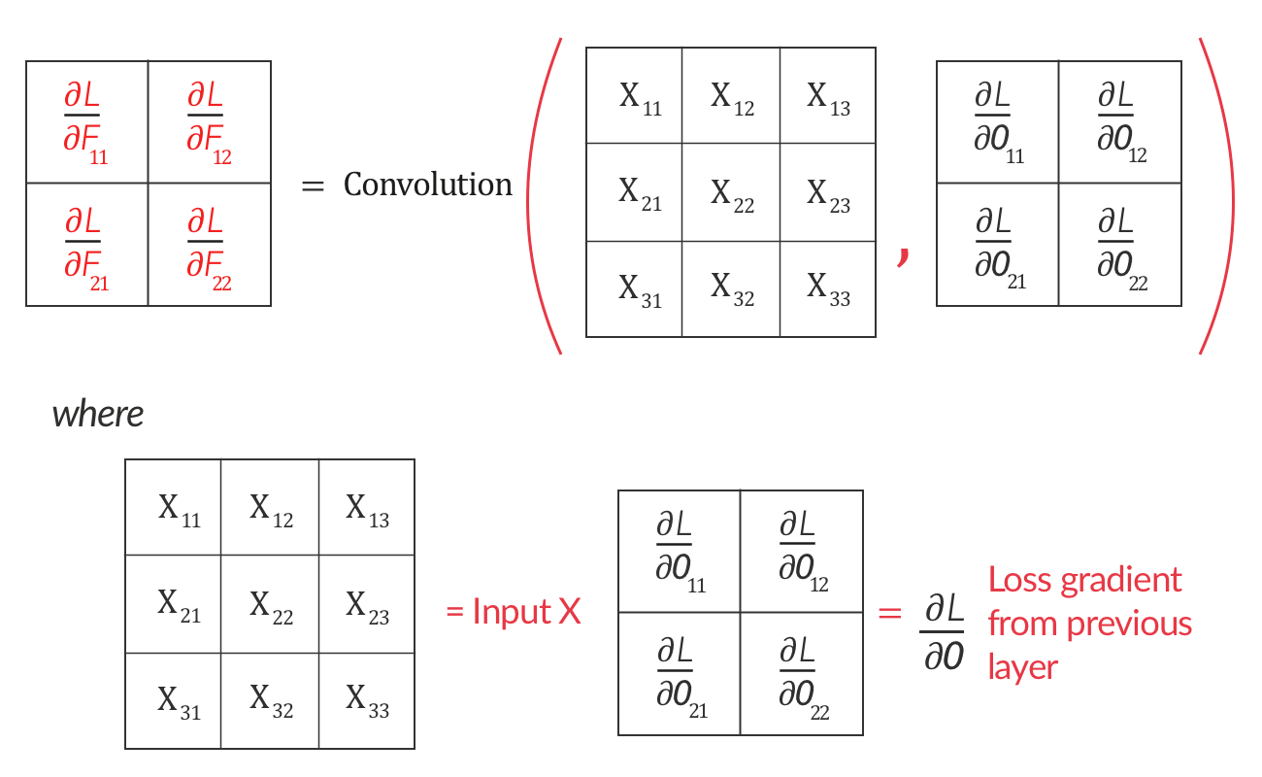
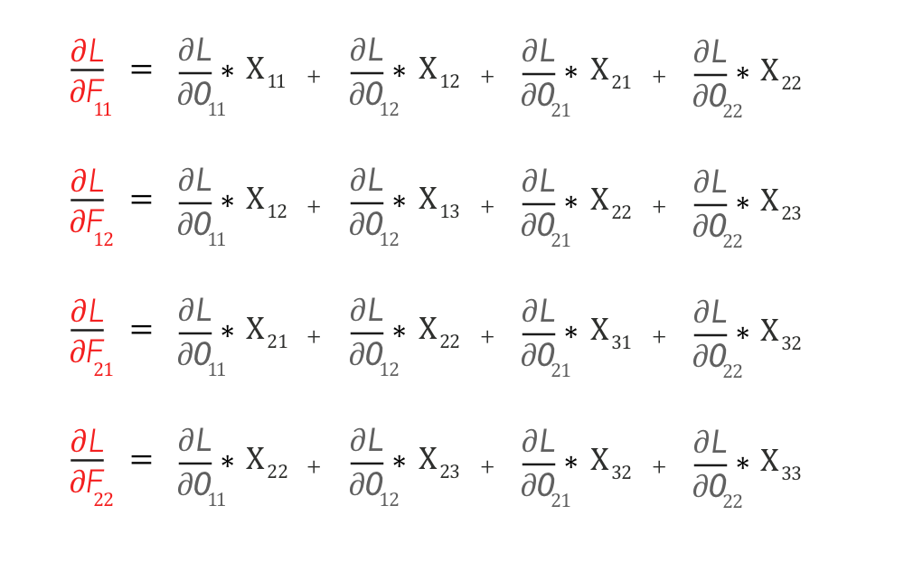
Loss gradient w.r.t the filter
If you closely look at it, this represents an operation we are quite familiar with. We can represent it as a convolution operation between input X and loss gradient ∂L/∂O as shown below:

Slide 8
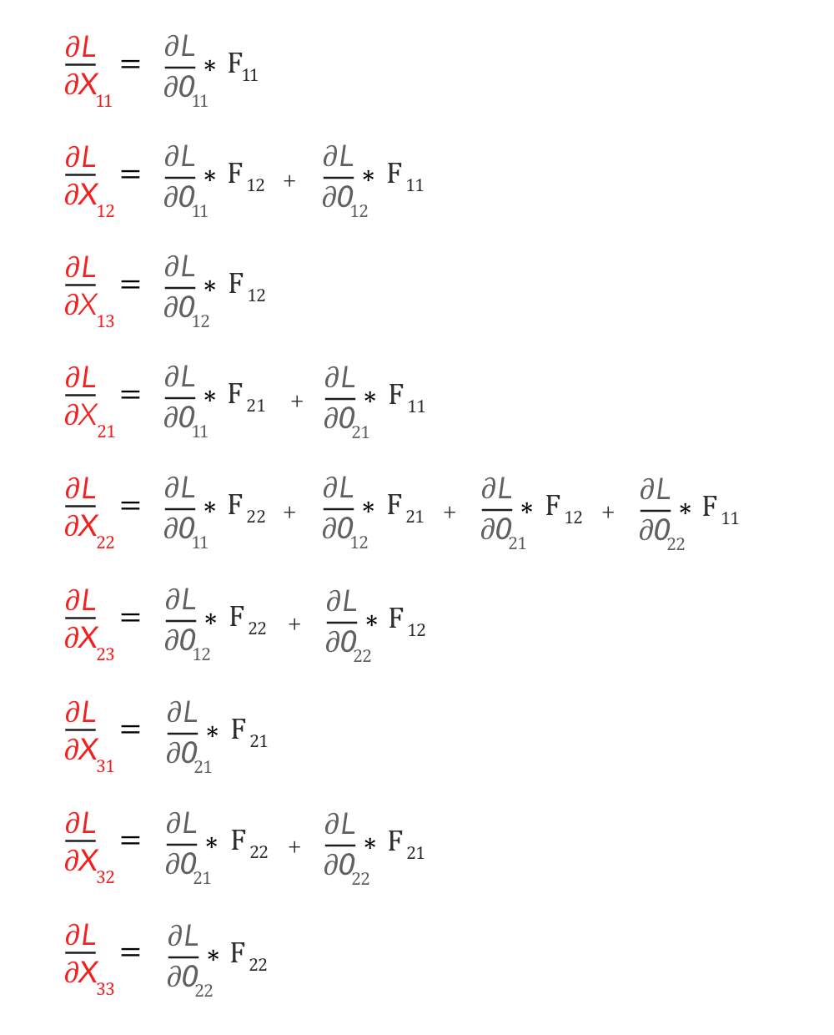
Loss gradient w.r.t the input
If you closely look at it, this represents an operation we are quite familiar with. We can represent it as a convolution operation between input X and loss gradient ∂L/∂O as shown below:

Slide 9
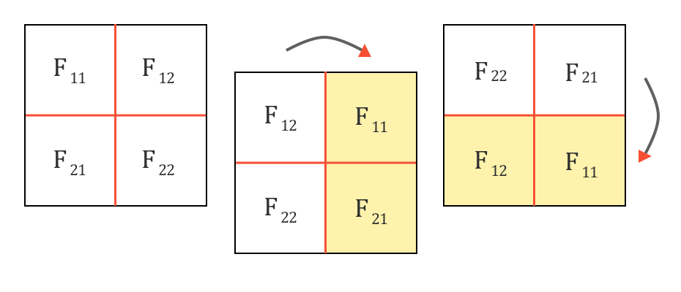
Loss gradient w.r.t the input
First, let us rotate the Filter F by 180 degrees. This is done by flipping it first vertically and then horizontally.

Slide 10
Upsampling derivative map
do_upsample = zeros((H-1)x(S+1), (W-1)x(S+1) )
0 | 0 | 0 | 0
0 |  |  | 0
0 |  |  | 0
0 | 0 | 0 | 0
Upsample the downsampled derivatives
This gives us the derivatives w.r.t. all the entries of a full-sized (stride 1) map

Slide 11
Loss gradient w.r.t the input
If you closely look at it, this represents an operation we are quite familiar with.
We can represent it as a convolution operation between input X and loss gradient ∂L/∂O as shown below:

Slide 12
Takeaway
Both the Forward pass and the Backpropagation of a Convolutional layer are Convolutions

Slide 13
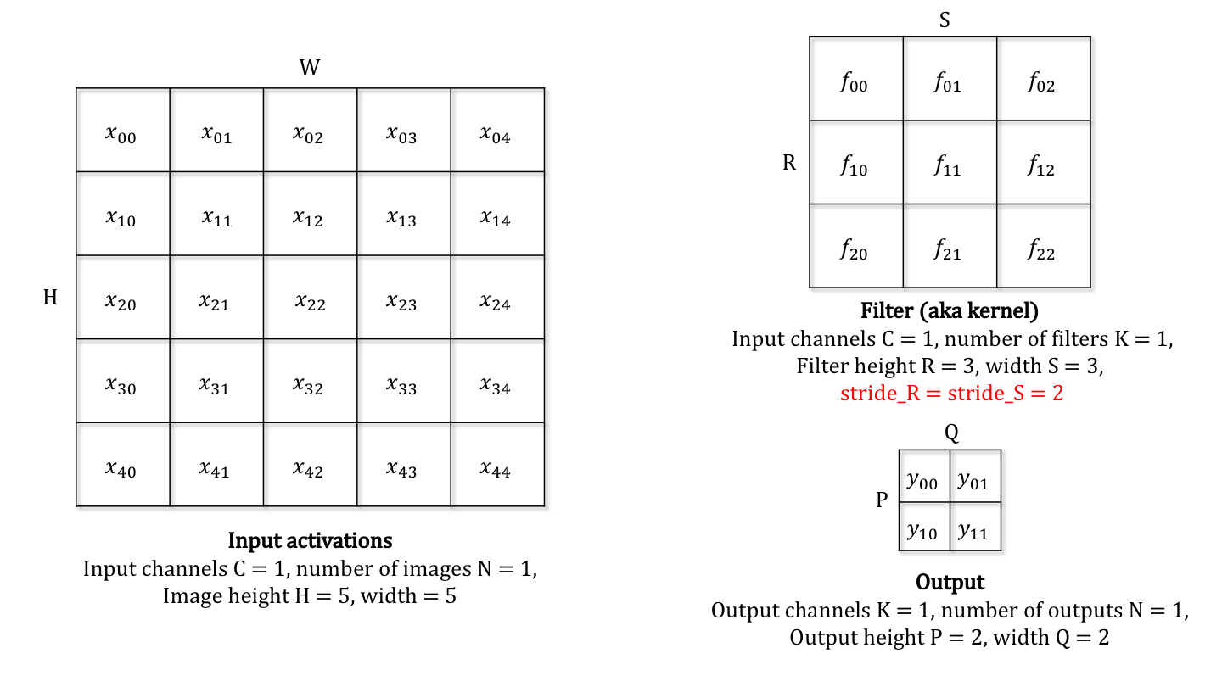
Loss gradient w.r.t the input
To understand the computation of loss gradient w.r.t input, let us use the following example:
> Horizontal and vertical stride = 2

Slide 14
Recap: Forward pass
This is how the forward pass looks like for the example:

Slide 15
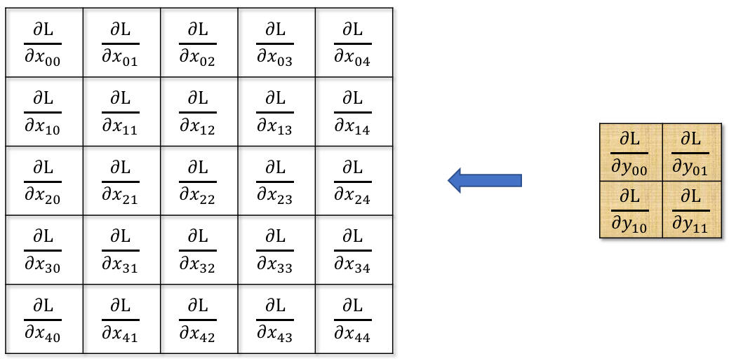
Backward Pass:
Loss gradients w.r.t
input
Loss gradients w.r.t
output
Assumption: we have the loss gradient w.r.t the output pixels.
Requirement: calculate the loss gradient w.r.t the input activations

Slide 16
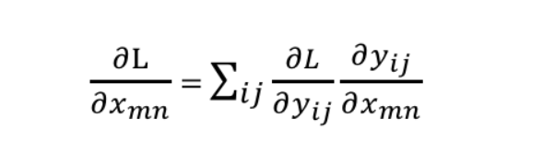
Backward pass:
Each input contributes to one or more outputs. The total gradient of the loss wrt to each input pixel is computed using the formula shown
The gradient computation is done using chain rule and partial differentiation
i and j represent the position of a single output pixel

Slide 17
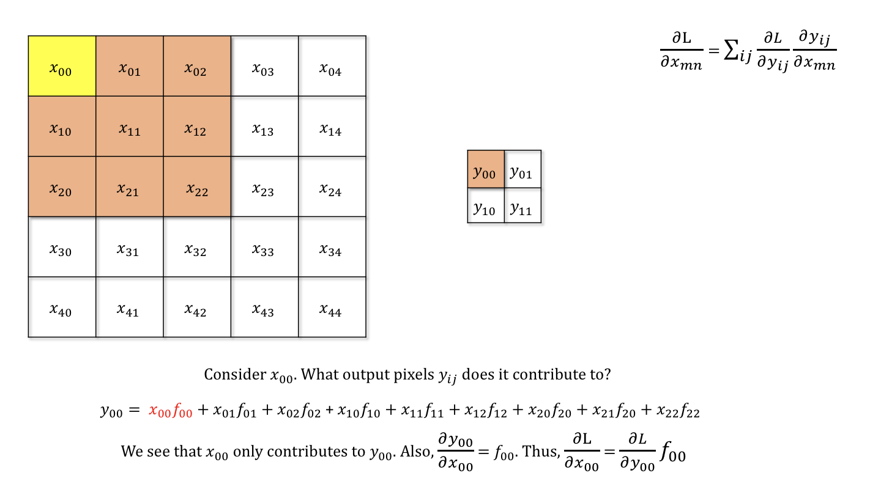
Backward Pass example:
Consider input x₀₀ in the input shown. It contributed to the output y₀₀

Slide 18
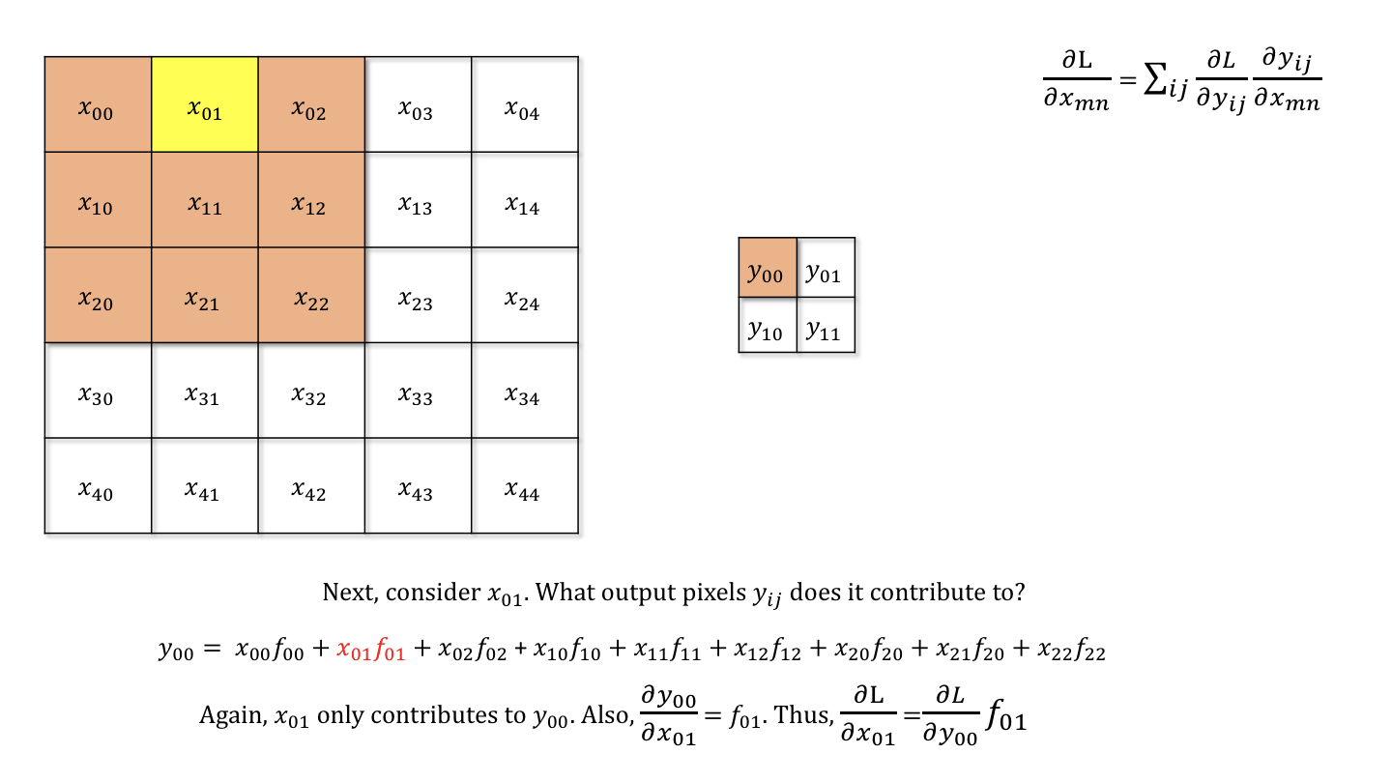
Backward Pass example:
Input x₀₁ also contributed to the output y₀₀ so the loss gradient w.r.t x₀₁ is computed as shown:

Slide 19
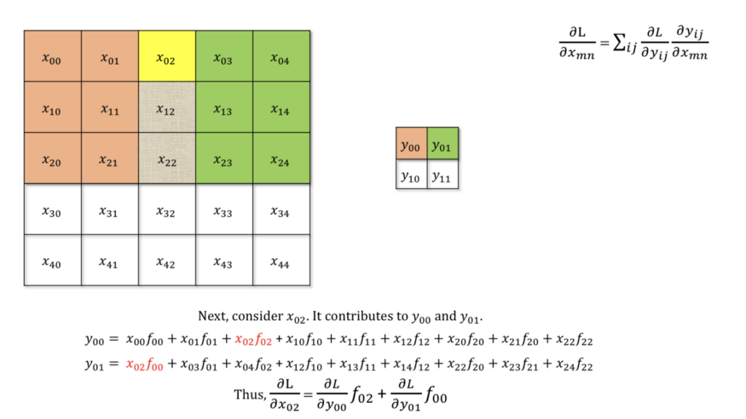
Backward Pass example:
Input x₀₂ contributed to the output y₀₀ and y₀₁ so the loss gradient w.r.t x₀₂ is computed as shown:

Slide 20
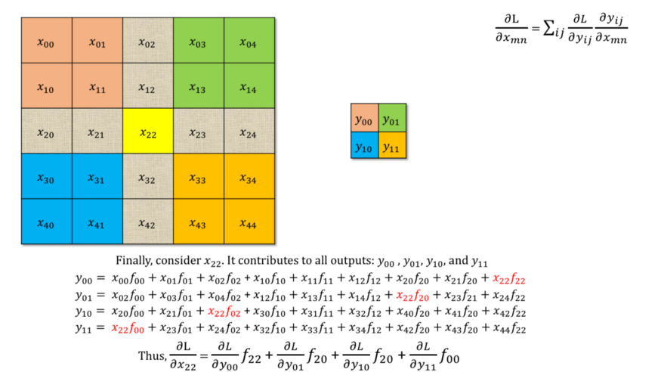
Backward Pass example:
Input x₂₂ contributed to the output y₀₀ , y₀₁ , y₁₀, and y₁₁ so the loss gradient w.r.t x₂₂ is computed as shown:

Slide 21
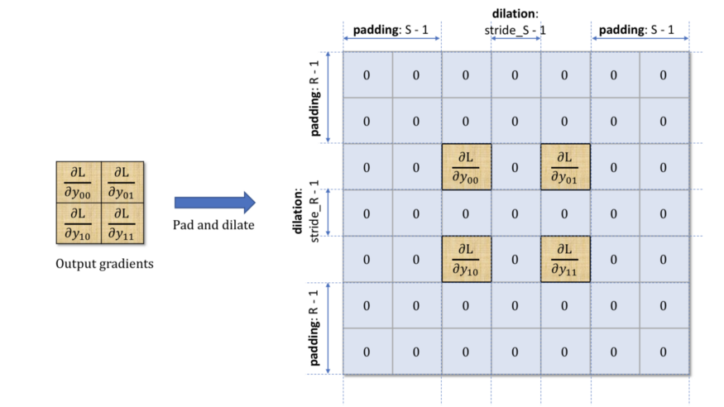
Backward Pass example:
To visualize the pattern more clearly, we pad the gradient tensor with zeros at the top and bottom as well as to the left and right.
The number of zeros padded on either side is equal to the stride (horizontal and vertical)
We also dilate the output gradient pixels with the stride – vertically and horizontally

Slide 22
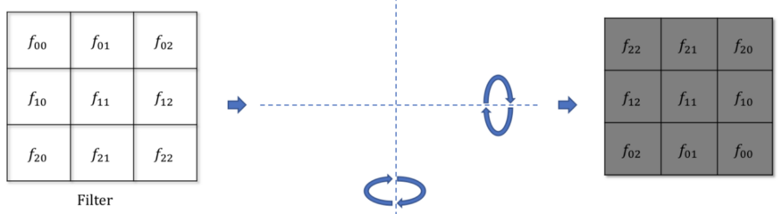
Backward Pass example:
We also rotate the filter vertically and horizontally as shown:

Slide 23
Backward Pass example:
After these modifications, we can now see the calculation of the gradient tensor as follows:

Slide 24
Takeaway:
Convolving with a stride greater than 1 is the same as convolving with stride 1 and “dropping” out of every rows, and of every columns
Padding the gradient of the output after dilation helps recover the size of the input feature map

Slide 25
Loss gradient w.r.t the Filter
To understand the computation of loss gradient w.r.t filter, we will use the same example:
> Horizontal and vertical stride = 2

Slide 26
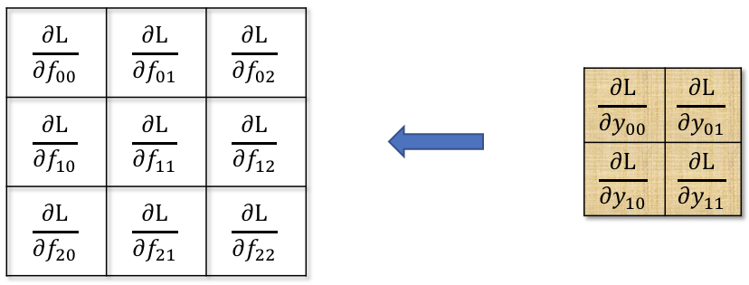
Backward Pass:
Loss gradients w.r.t
filter
Loss gradients w.r.t
output
Assumption: we have the loss gradient w.r.t the output pixels.
Requirement: calculate the loss gradient w.r.t the filter

Slide 27
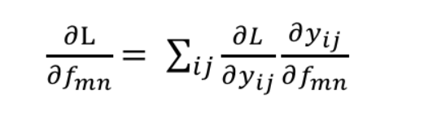
Backward pass:
Unlike the inputs which contribute to some outputs, each filter contributes to all outputs
The gradient computation is done using chain rule and partial differentiation
i and j represent the position of a single output pixel

Slide 28
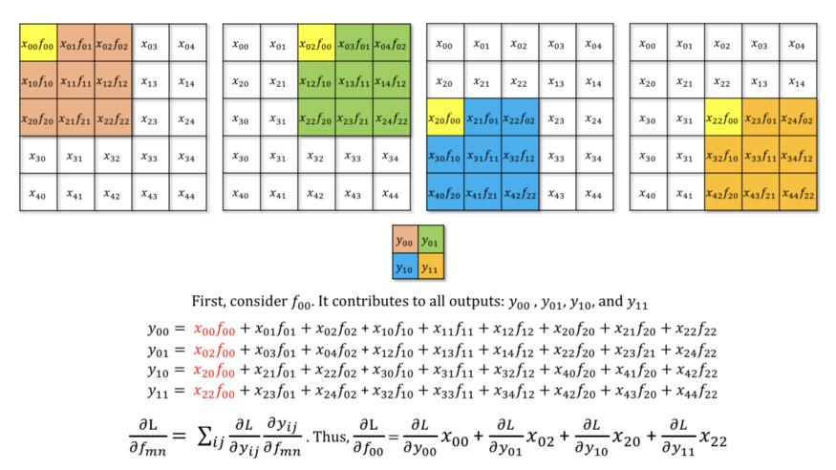
Backward Pass example:
Considering the filter f₀₀ , the loss gradient is computed as shown:
Notice the inputs involved in the computation

Slide 29
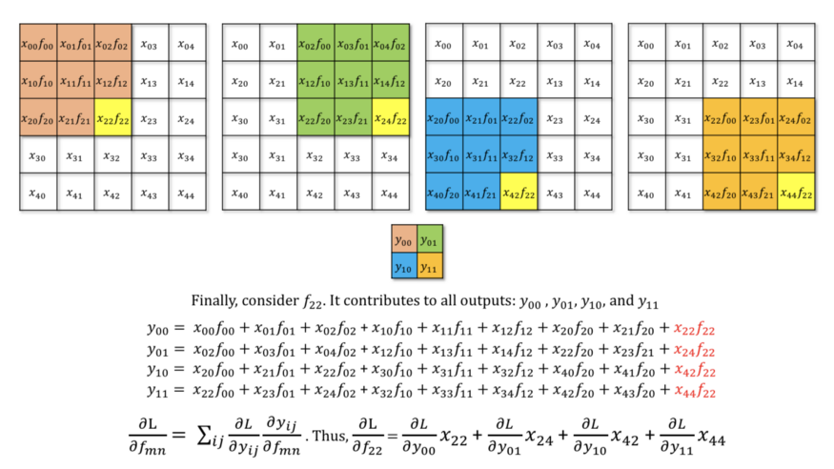
Backward Pass example:
Considering the filter f₂₂ , the loss gradient is computed as shown:
Notice the inputs involved in the computation

Slide 30
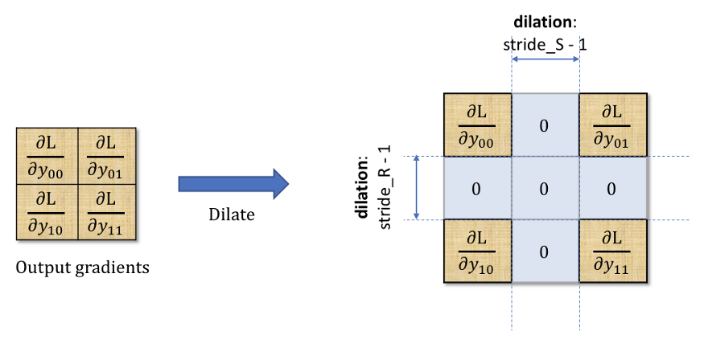
Backward Pass example:
To visualize the underlying pattern, we will modify the output gradient tensor by dilating the pixels with the stride vertically and horizontally:

Slide 31
Backward Pass example:
After these modifications, we can now see the calculation of the filter gradient tensor as follows :

Slide 32
Takeaway:
The CNN Backpropagation operation with stride>1 is identical to a stride = 1 Convolution operation of the input gradient tensor with a dilated version of the output gradient tensor!

Slide 33
References:
https://medium.com/@mayank.utexas/backpropagation-for-convolution-with-strides-8137e4fc2710
https://medium.com/@mayank.utexas/backpropagation-for-convolution-with-strides-fb2f2efc4faa

